Slide 1

Analyse E-Commerce Sales & Retention (Retail Tech)
      Name : Prashik Ganesh Gawai
Professional Program in Data Analytics with GenAI-71
MENTOR :- ASHISH RAJPUT
PROJECT TYPE :- CAPTION PROJECT

Slide 2
Analyse E-Commerce Sales & Retention (Retail Tech)
➡️ E-Commerce Sales & Retention Analysis
➡️ Customer Purchase Behavior
Introduction
➡️ Sales Trend Analysis
➡️ Product & Customer Insight
➡️ Retention & Repeat Purchase Analysis
➡️ Business Performance Evaluation
➡️ Business Performance Evaluation
➡️ Data-Driven Decision Making

Slide 3
DATASET SOURCE
Dataset Source : NIIT Portal
Dataset Name : E-Commerce Sales & Retention (Retail Tech)
About Dataset
Covers customer, orders, products, reviews, and location data.
Includes sales, pricing, discounts, shipping, and delivery information.
Supports customer behaviour, retention, and sales performance analysis.
Suitable for Excel, SQL, Python, Power BI, and Machine Learning.
Used to generate business insights and improve decision-making.

Slide 4
DATASET INFORMATION
Dataset | Records | Columns | Description | Link
1.Customer.excel | 90,000 | 5 | Stores customer demographics and segmentation details. | https://shorturl.at/5CrH4
2.Orders.excel | 99,999 | 10 | Contains order details, status, payment, and delivery information. | https://shorturl.at/DUQeP
3.Order_items.excel | 190 | 8 | Includes product-level order details such as quantity, price, discount, and shipping cost. | https://shorturl.at/qbAfO
4.Product.excel | 1,50,000 | 7 | Contains product information including category, brand, cost price, and selling price. | https://shorturl.at/ilWz7
5.Review.excel | 97,019 | 6 | Stores customer ratings, reviews, and feedback for delivered orders. | https://shorturl.at/AFu1m
6.Location.excel | 1,55,545 | 6 | Contains customer location details such as city, state, region, and coordinates. | https://short.do/Q1Mne-

Slide 5


Project Flow
Data
Collection
Data
Cleaning
  Excel
  Analysis
SQL Analysis
Python Analysais
(User Engagement, Visualisation)
Viewing
Behaviour
Exploratory Data Analysis
(Feedback)
Power BI
Dashboard
Machine
Learning
Business
Insights
📄 Final Report

Slide 6
BUSINESS OBJECTIVES & TASKS
Business Objectives | Tasks | Tools
Objective 1: Evaluate E-Commerce Conversion and Cancellation Trends | Task 1 - Identify categories with highest conversions and lowest cancellations. Task 2 - Identify highest-converting products and lowest-cancellation subcategories. Task 3 - How do conversion rates vary by customer segment (New vs. Loyal)? Task 4 - How do conversion rates vary by gender, and age group? | Microsoft Excel
Objective 2: Analyse Customer Retention & Repeat Purchase Behaviour | Task 1 - Identify categories and brands with highest repeat purchases. Task 2 - Analyse repeat purchases across segments, gender, and age. Task 3 - Analyse Pricing Impact on Repeat Purchases Task 4 - Monitor Retention Through Delivery Performance | MySQL
Objective 3: Optimize Pricing, Discounts & Shipping for Profitability | Task 1 - Analyse Profit Across Categories and Brands Task 2 - Analyse Discount Impact on Purchase Conversion. Task 3 - Analyse Shipping Cost Impact on Profitability. Task 4 - Optimize Pricing and Discount Strategies. | Python

Slide 7
Objectives (Continue)
Business Objectives | Tasks | Tools
Objective 4: Exploratory Data Analysis (EDA) to Discover Business Insights | Task 1 - Analyse Sales and Revenue Trends. Task 2 - Analyse Pricing Correlations with Order Value. Task 3 - Identify Outliers in Sales Data. Task 4 - Visualize Customer and Sales Trends. | Python EDA
Objective 5: Analyse Customer Reviews & Retention Insights | Task 1 - Which payment type generates highest profit? Task 2 - How does revenue vary by gender? Task 3 - How do orders and revenue trend monthly? | Power BI
Objective 6: Predict Customer Purchase & Retention | Task 1 – Analyse customer purchase conversion and repeat purchases. Task 2 – Predict Customer Repeat Purchases Using Machine Learning. Task 3 – Compare Customer Retention Classification Models. Task 4 – Evaluate Classification Models for Business Decisions | Statistics and Machine Learning

Slide 8
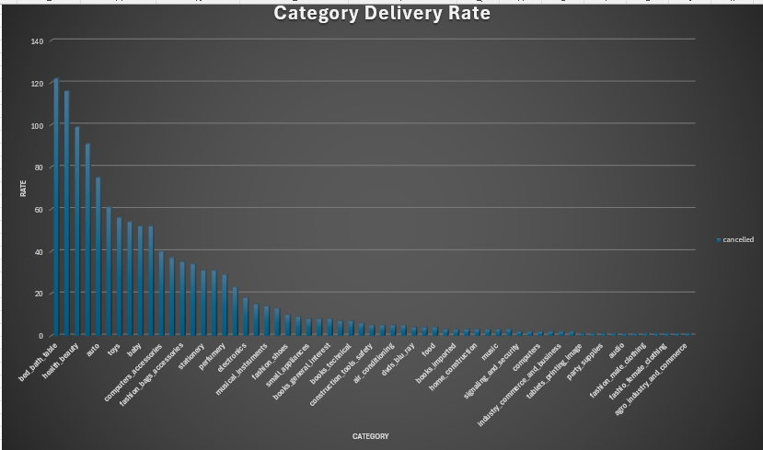
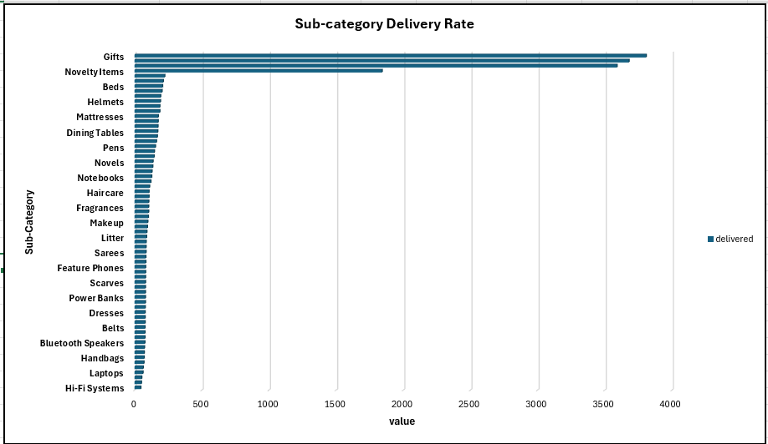
OBJECTIVE 1 :- Evaluate E-Commerce Conversion and Cancellation Trends
Category-wise Purchase Conversion Analysis
Highest Converting Product Subcategories
Interpretation :- Bed Bath Table (⬆️) & Cds_Dvds_Musicals(⬇️)
highest purchase lowest purchase conversion rates rates.
Interpretation :- Tablets_Printing_Image(⬆️) & Fashion_Sport(⬇️) highest purchase lowest purchase conversion rates rates
Notes:
I compared categories and subcategories to identify high and low purchase conversion rates.
The analysis helps identify which products perform well and where improvement is needed.

Slide 9
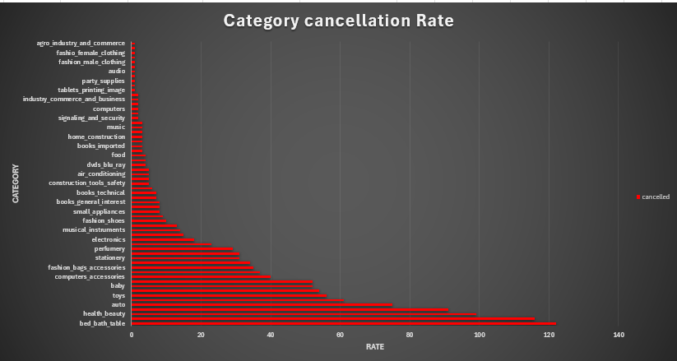
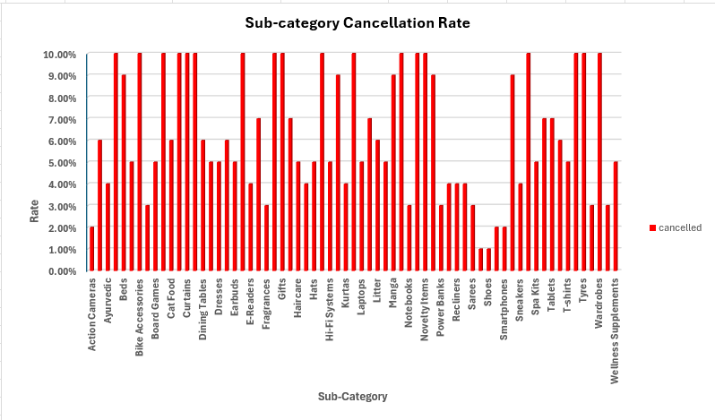
OBJECTIVE 1 :- Evaluate E-Commerce Conversion and Cancellation Trends (Continue)
Cancellation Rates by Product Category
Subcategory Cancellation Rate Analysis
Interpretation :- Bed Bath Table, sports_leisure (⬆️) & tablets_printing_image, furniture_bedroom,(⬇️)
highest purchase lowest purchase conversion rates rates.
Gifts, General Merchandise (⬆️) & Scarves and Shoes (⬇️) highest purchase lowest purchase conversion rates rates
Notes:
This slide shows the cancellation rates across different product categories and subcategories.
This helps the business understand where it can reduce cancellations and improve conversions.

Slide 10
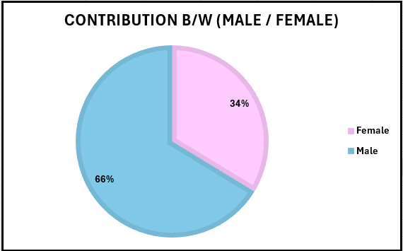
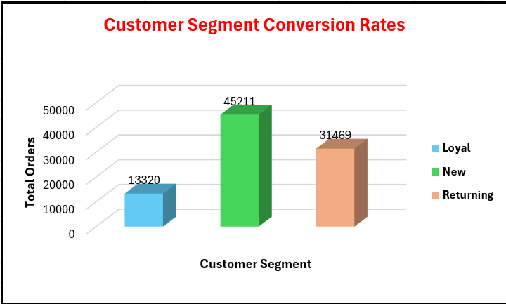
OBJECTIVE 1 :- Evaluate E-Commerce Conversion and Cancellation Trends (Continue)
Gender-wise Purchase Conversion Rates
Customer Segment Conversion Rates
Male contribution (66%) ⬆️ is much more than Female 34%
New Customer (50%) ⬆️ purchasing more product than loyal & Returning Customer
Notes:
Male customers contribute 66%, higher than females at 34%.
New customers have the highest number of purchases compared with loyal and returning customers.

Slide 11
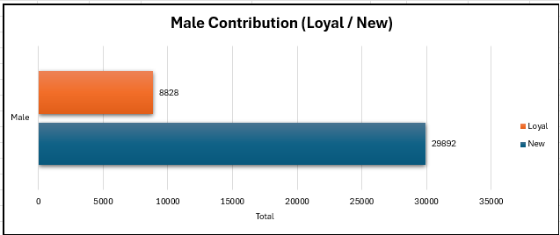
OBJECTIVE 1 :- Evaluate E-Commerce Conversion and Cancellation Trends (Continue)
Female Conversion by Customer Segment
Male Conversion by Customer Segment
Female New Customer ⬆️ has more contribution for purchasing product than Loyal Female Customer
Male New Customer ⬆️ has more Contribution for purchasing product than Loyal Male Customer

Slide 12
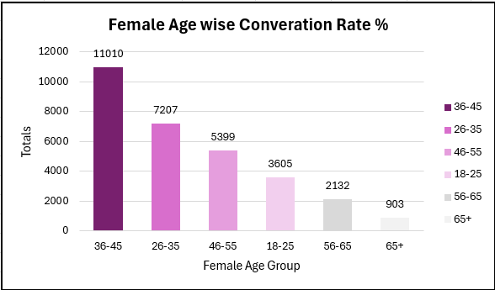
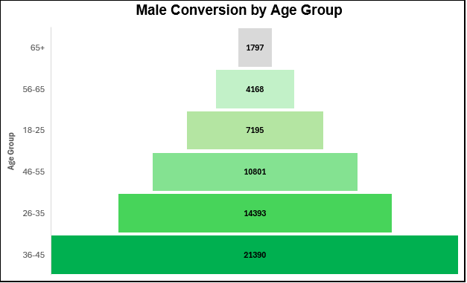
OBJECTIVE 1 :- Evaluate E-Commerce Conversion and Cancellation Trends (Continue)
Female Conversion by Age Group
Male Conversion by Age Group
Age b/w 36-45 in Female taking more product than other age group in Female
Age b/w 36-45 in Male taking more product than other age group in Male

Slide 13
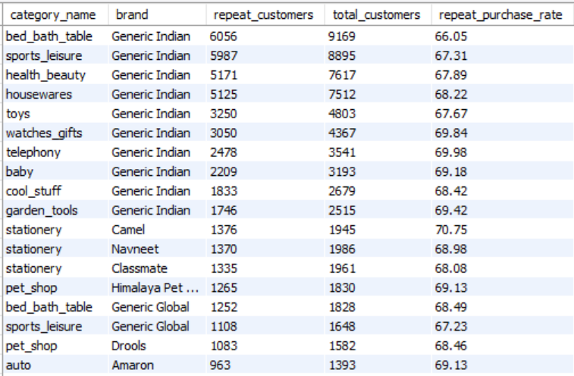
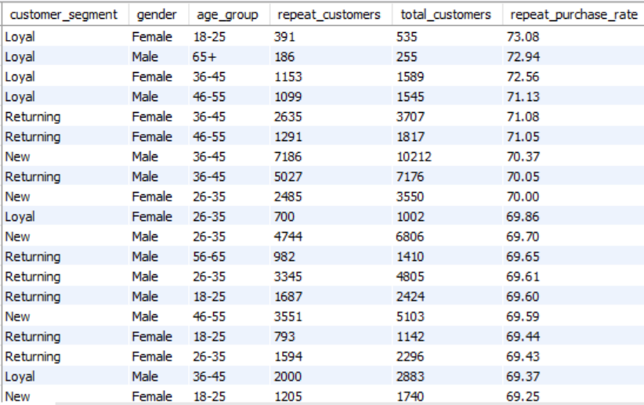
OBJECTIVE 2 :- Analyse Customer Retention & Repeat Purchase Behaviour
Category & Brand Repeat Purchases
Repeat Purchases by Customer Segment
Stationery – Camel (70.75%) & Telephony – Generic Indian (69.98%) have the highest repeat purchase rates among category & brands.
Loyal Customer (73%), New (70.37%), Return (71%) highest repeat purchase rates, while New customers show comparatively lower repeat purchases.

Slide 14
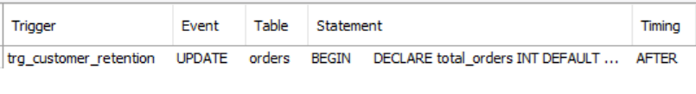
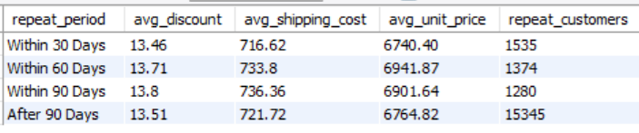


OBJECTIVE 2 :- Analyse Customer Retention & Repeat Purchase Behaviour (Continue)
Repeat Purchase Within 30/60/90 Days
Customer Retention Trigger Analysis
Before
After
Trigger
Discounts remain fairly stable (around 13.5%–13.8%) across all periods, indicating they have limited influence on repeat purchase timing.
Automatically inserts retention details into the Customer Retention table.

Slide 15
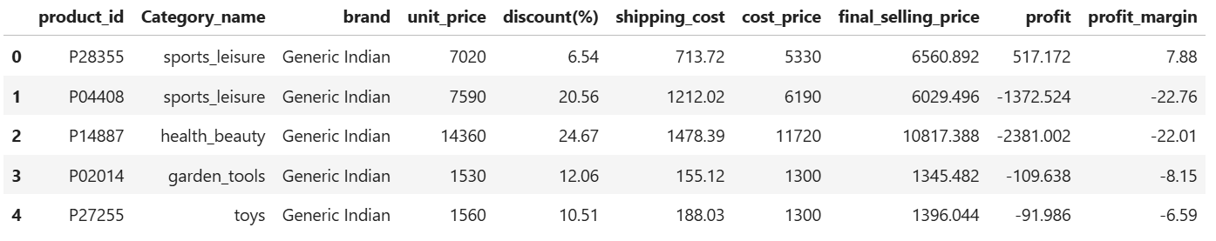
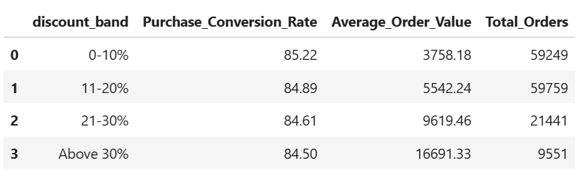
Objective 3: Optimize Pricing, Discounts & Shipping for Profitability
Item-Level Profit Margin Analysis
Discount Band Impact Analysis
As discount bands increase, the Average Order Value (AOV) rises significantly, while the Purchase Conversion Rate remains nearly stable at around 85%.
After removing discount & Shipping cost we get sports leisure – Generic Indian with 7.88 profit margin

Slide 16
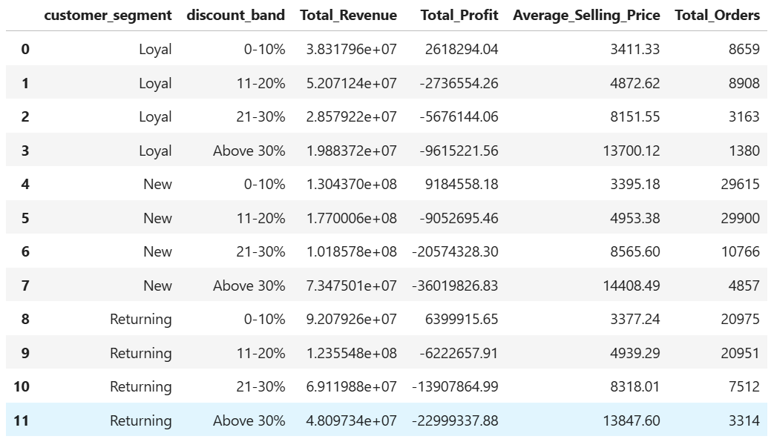
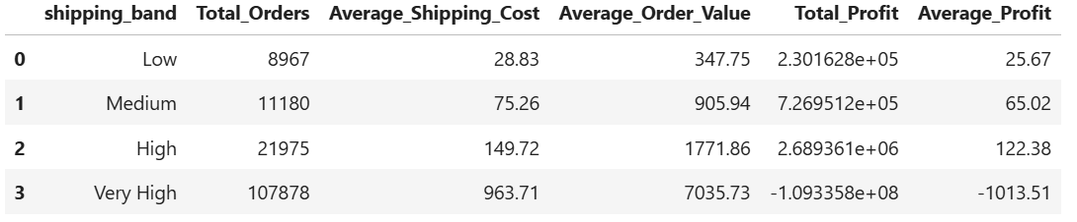
Objective 3: Optimize Pricing, Discounts & Shipping for Profitability (Continue)
Pricing and Discount Strategy Analysis
Shipping Cost Profitability Analysis
Best for Customers: Low Shipping Band – lowest shipping cost with affordable orders.
High Shipping Band – generates the highest average profit (₹122.38) while remaining profitable.
A 0–10% discount is the optimal pricing strategy, as it maximizes profit across all customer segments while New customers generate the highest revenue and profit.

Slide 17
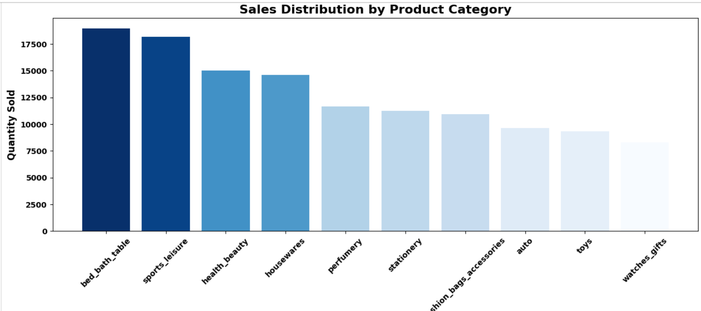
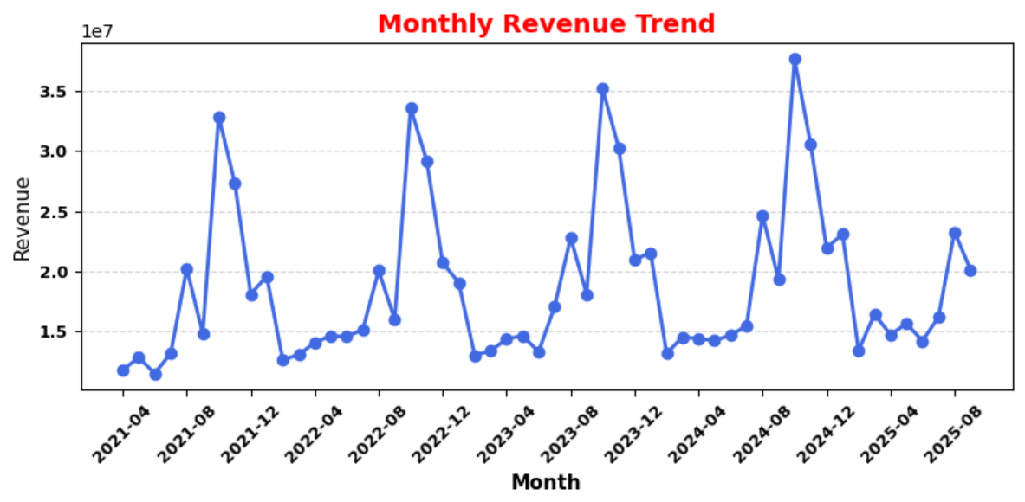
Objective 4: Exploratory Data Analysis (EDA) to Discover Business Insights
Task 1 - Analyze sales distribution, revenue trends, and customer purchasing patterns using visualizations.
Sales Distribution by Product Category (Bar Chart)
Monthly Revenue Trend (Line Chart)
Bed Bath Table is the highest-selling product category, followed by Sports & Leisure and Health & Beauty, indicating the strongest customer demand.
Revenue shows seasonal fluctuations, with the highest sales occurring around October–November each year.

Slide 18
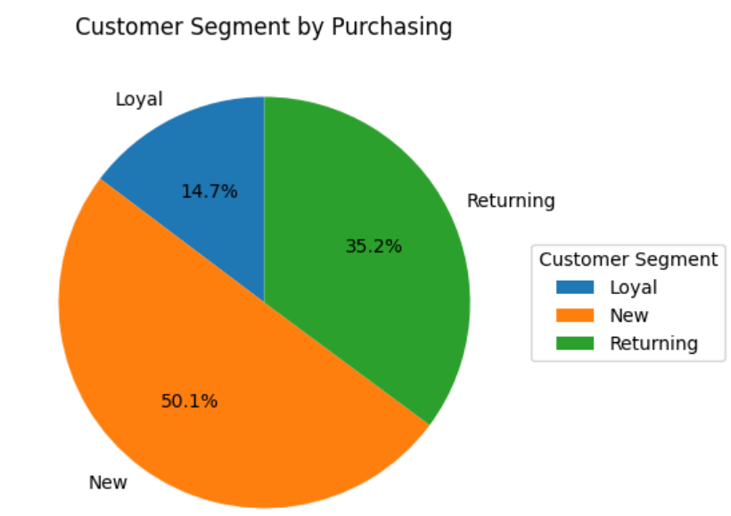
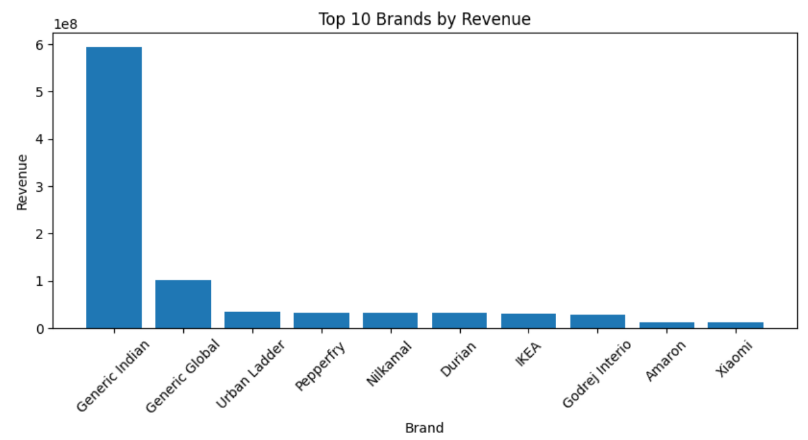
Objective 4: Exploratory Data Analysis (EDA) to Discover Business Insights (Continue)
Task 1 - Analyze sales distribution, revenue trends, and customer purchasing patterns using visualizations.
Customer Purchasing Pattern by Segment (Bar Chart)
Revenue by Brand (Top 10) (Bar Chart)
New customers dominate purchases (50.1%), followed by Returning (35.2%) and Loyal (14.7%).
Generic Indian is the top revenue-generating brand, significantly outperforming all other brands.

Slide 19
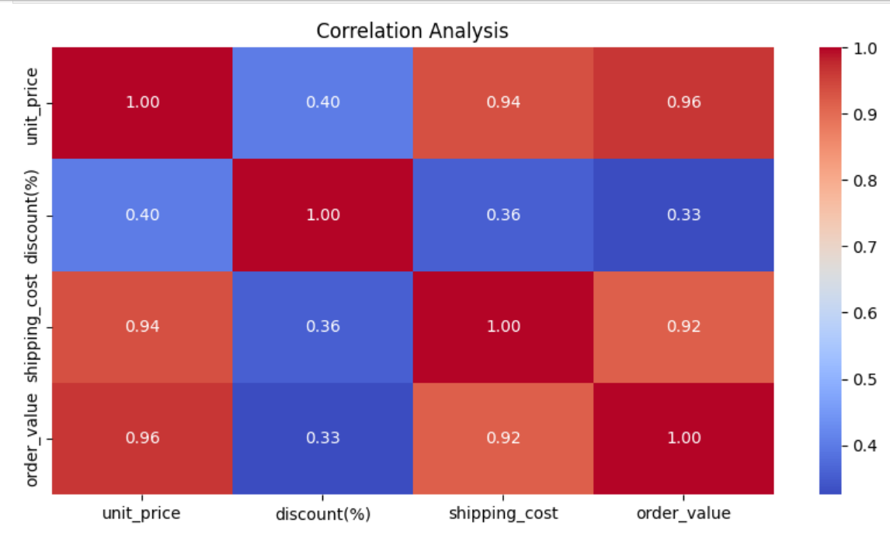
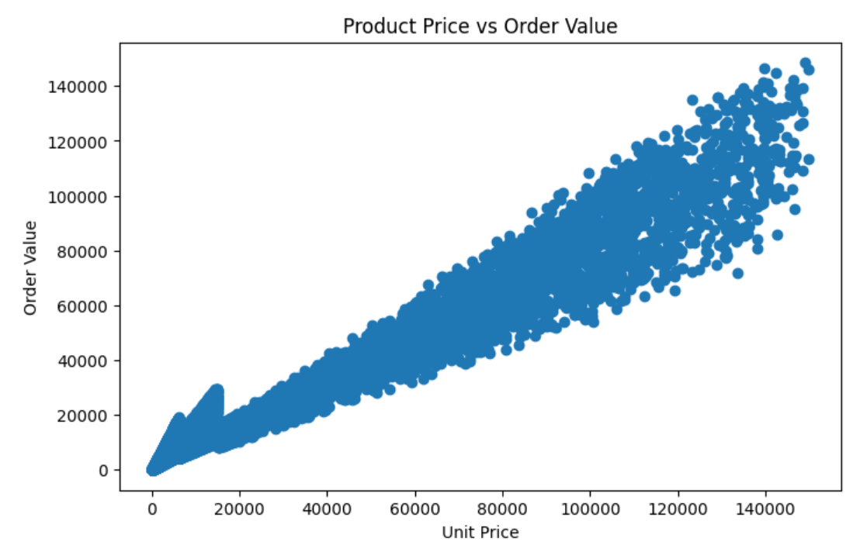
Objective 4: Exploratory Data Analysis (EDA) to Discover Business Insights (Continue)
Price and Discount Correlation Analysis
Customer Order Outlier Analysis
Order value has a strong positive correlation with unit price (0.96) and shipping cost (0.92), while discounts have a weak impact on order value (0.33).
Higher unit prices generally lead to higher order values, indicating a strong positive relationship between price and customer spending.

Slide 20
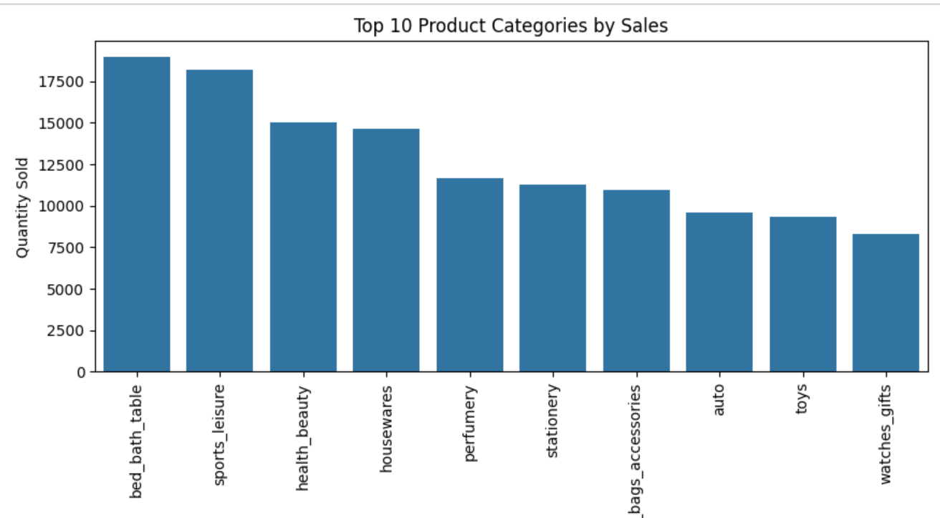
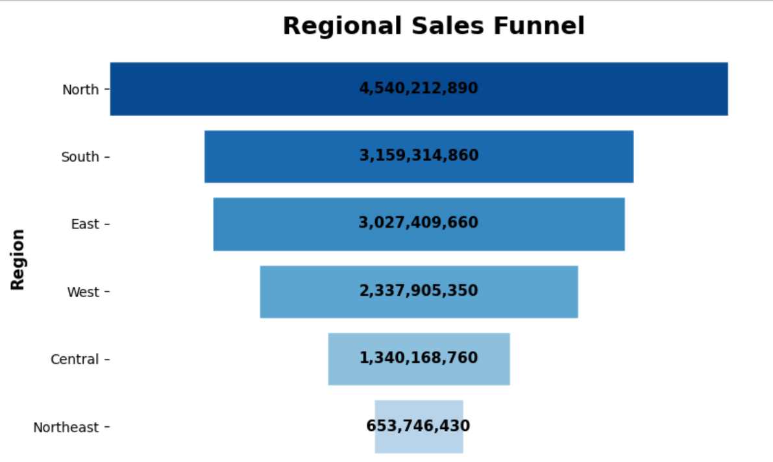
Objective 4: Exploratory Data Analysis (EDA) to Discover Business Insights (Continue)
Customer Demographics and Product Insights
Customer Demographics and Regional Sales.
Bed Bath Table is the highest-selling product category, followed by Sports & Leisure and Health & Beauty, indicating the strongest customer demand.
The North region generates the highest revenue, followed by the South and East, while the Northeast contributes the lowest sales.

Slide 21
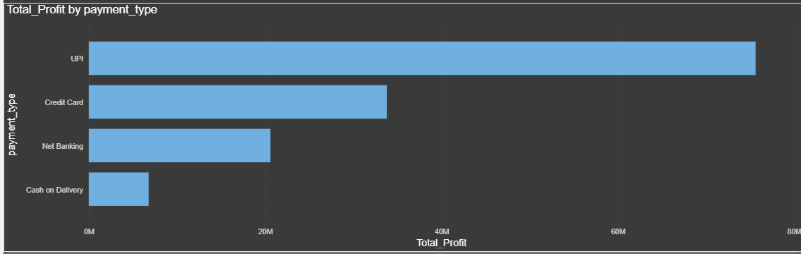
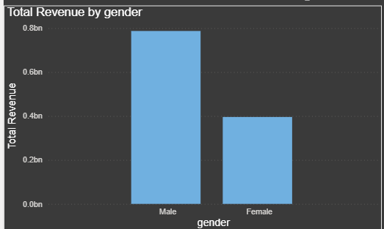
Objective 5: Analyze Customer Reviews & Retention Insights
Which payment type generates highest profit?
How does revenue vary by gender?
UPI generates highest profit, while Cash on Delivery generates lowest.
Male customers contribute significantly higher revenue than female customers overall.

Slide 22
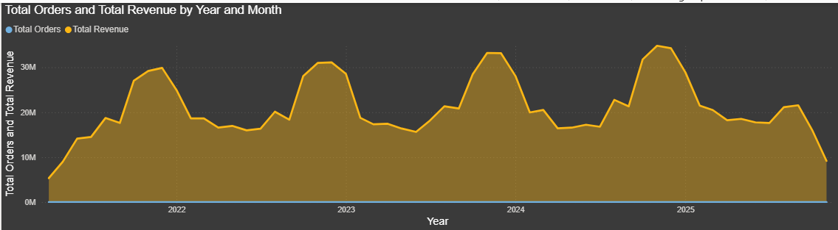
Objective 5: Analyze Customer Reviews & Retention Insights (Continue)
How do orders and revenue trend monthly?
Revenue fluctuates seasonally, peaking annually before declining toward year-end.

Slide 23
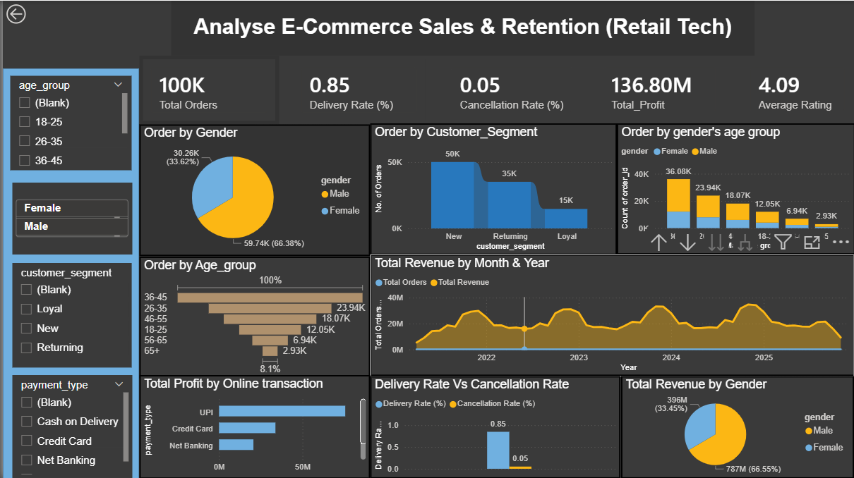
Dashboard

Slide 24
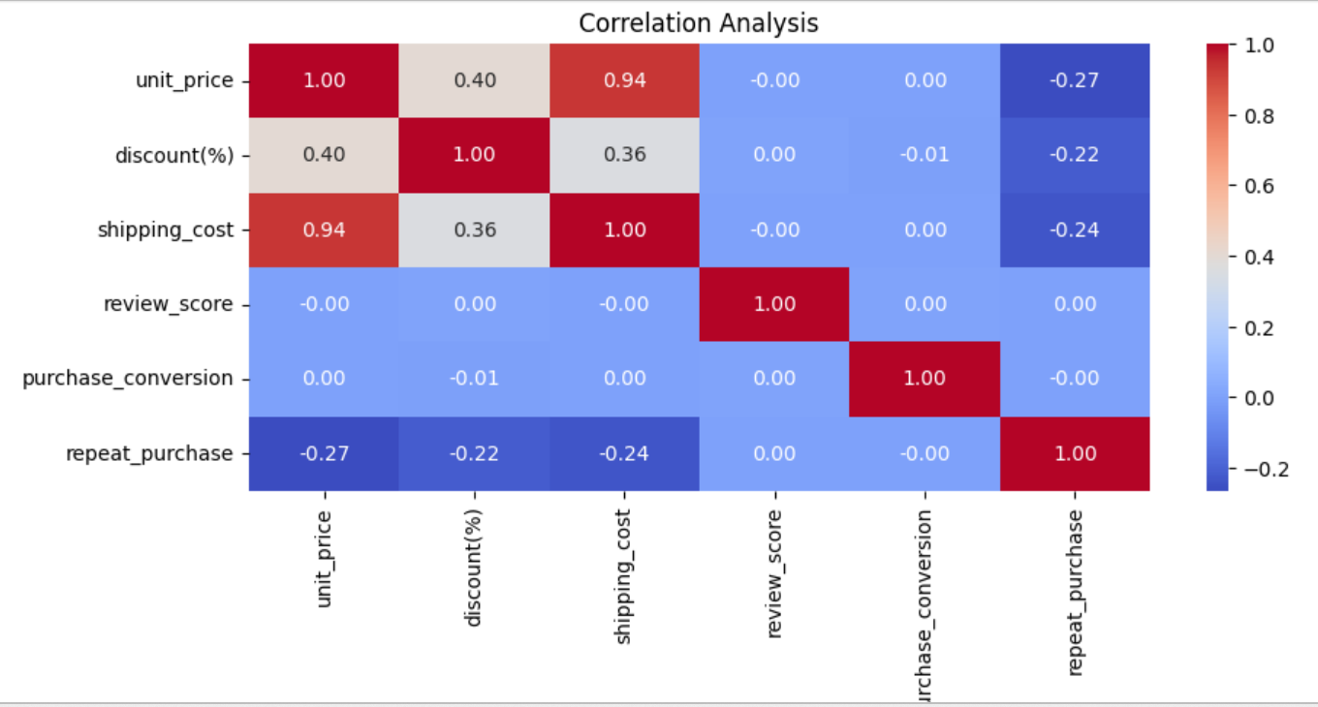
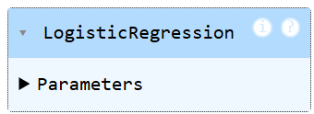


Objective 6: Predict Customer Purchase & Retention
Analyze customer purchase conversion and repeat purchases
Predict Customer Repeat Purchases Using Machine Learning
The Logistic Regression model predicts repeat purchases with an accuracy of approximately 94.16%, indicating strong predictive performance.
Correlation analysis identifies the relationships between customer purchase conversion, repeat purchases, and influencing factors.

Slide 25
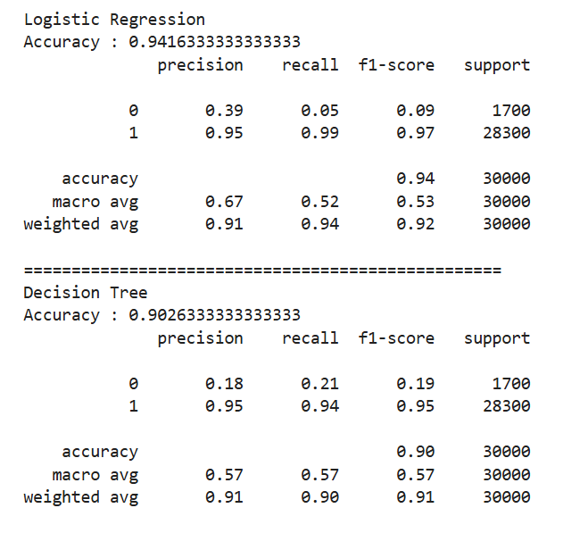
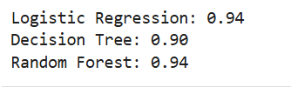
Objective 6: Predict Customer Purchase & Retention (Continue)
Compare Customer Retention Classification Models
Evaluate Classification Models for Business Decisions
Based on the classification metrics, Logistic Regression demonstrated the best overall performance and is recommended for customer retention prediction.
Logistic Regression and Random Forest achieved the highest accuracy (94%), outperforming the Decision Tree model (90%).

Slide 26
Summery
1. Collected E-Commerce Sales & Retention datasets from the NIIT portal.
2. Analysed customer behaviour, conversion, cancellations, and repeat purchases.
3. Compared purchasing patterns across segments, gender, age, regions.
4. Identified high-performing products, categories, brands, and customers.
5. Presented insights using interactive dashboards and reports.
6. Analysed pricing, discounts, shipping costs, and profitability.
7. Predicted customer repeat purchases and retention
8. Recommended strategies to improve retention, profitability, and performance.

Slide 27
Conclusion
Successfully analysed e-commerce sales, customer behaviour, and retention.
2. Identified key factors influencing conversion, profitability, and purchases.
3. Generated insights supporting customer retention and pricing strategies.
4. Predicted customer repeat purchases for proactive decision-making.
5. Developed interactive dashboards for effective business performance analysis.
6. Demonstrated data-driven insights for better business decisions.

Slide 28
Thank You

